Slide 1
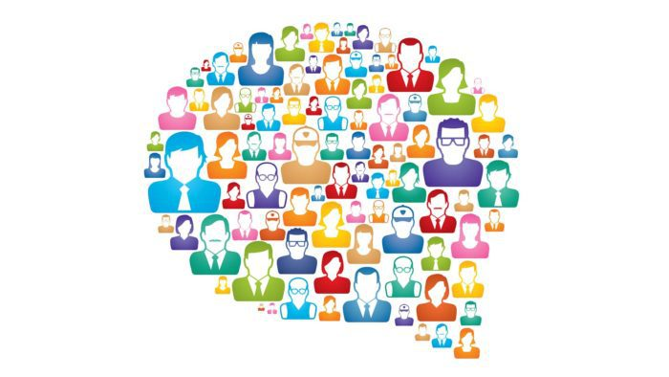
Humor Analysis on Online Crowdsourced Content
EXPLORING THE INTERSECTION OF
AI AND LAUGHTER
AVERY P., SCARLETT H., CASIDHE P.
MALCOM F., DICKSON A.
Mentor: Dr. Satadisha Saha Bhowmick

Slide 2
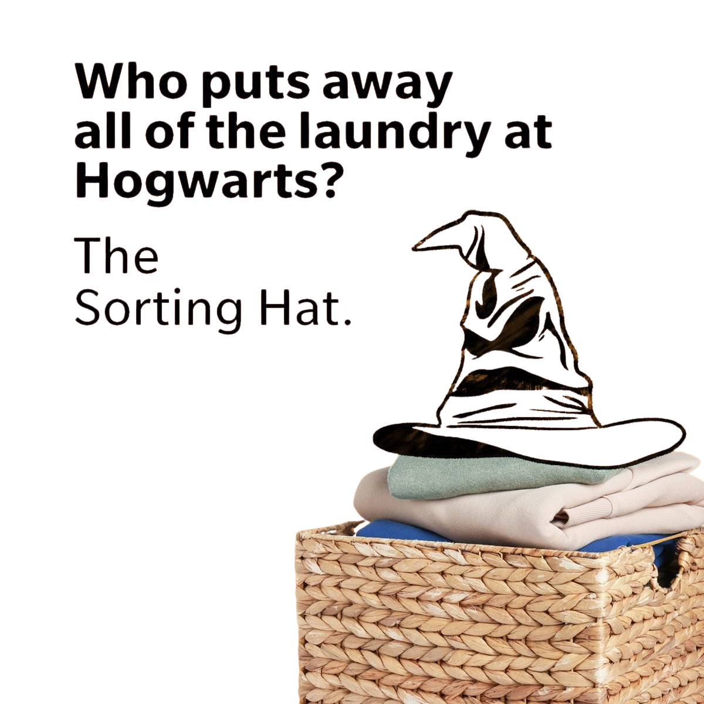
Mission Statement
Humor is prevalent in online textual content but not always benign.
Can be a source of trolling and negativity. Can also be used to mask harmful effects of biased or prejudicial views.
Understanding humor can often help to eradicate discrimination, harassment and cyberbullying in online spheres.
Application: facilitating content moderation pipelines of social media platforms like X, Quora, Reddit etc.

Slide 3

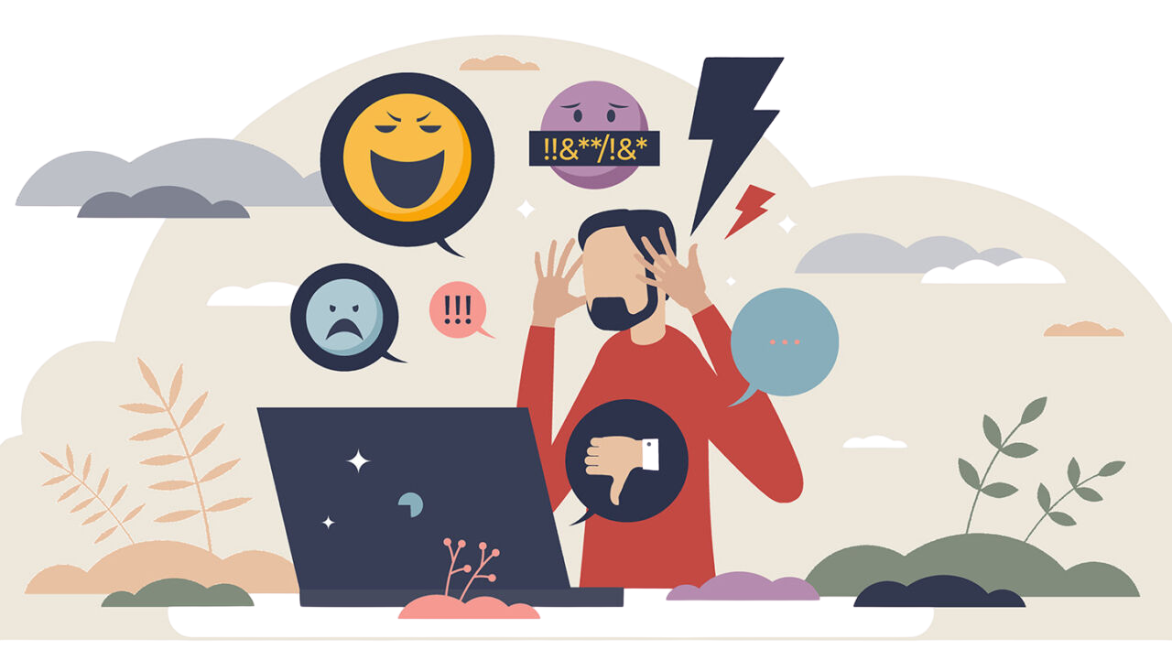
So you think this is funny?
I’ve got a friend who has got a butler whose left arm is missing, serves him right!
Yelled at some skinhead today & he was like “chemotherapy dude” & I was like “whatever, racist!” cause sometimes you gotta take a stand!
Did you hear about a terrorist with house fetish? He blew his house.

Slide 4
Research Questions
1.
2.
3.
How can we effectively identify and categorize offensive text?
What annotation framework can help us comprehensively understand humor in online speech?
How well do state-of-the-art language models perform in humour understanding tasks?

Slide 5

Proposal
Annotation Task
Language Task
Reproducibility of labels
Lit review and background research to develop a comprehensive humor annotation framework.
Annotated dataset of jokes from crowdsourced content
Humor annotation with LLMs:
Prompt Engineering
Fine Tuning
Performance in language task informs us of the feasibility of annotation structure in practice

Slide 6
1
Annotation Framework and Dataset

Slide 7


Challenges with Annotating Humor
Annotating humor is a complex and time-consuming task.
Humor is subjective, people do not have the same view on jokes.
Several mechanisms are used to convey humor within text.

Slide 8


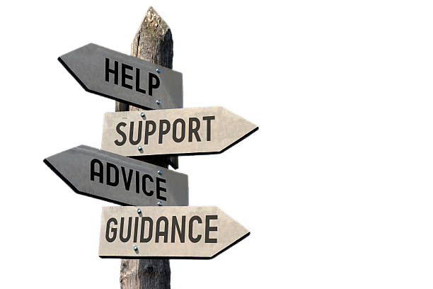
Analyze each joke carefully and have two independent annotators to review it.
A mediator resolves annotation disputes.
Annotation Guidelines
How do we respond to challenges?
Set clear definitions for each mode of categorization and its corresponding labels.
Uniformity and consistency are key.
Incremental approach to annotation and testing.

Slide 9

Annotation Framework
Categories | Classification Tasks
Classification Label - 5 Labels | Binary & MultiClass
Target - 11 Labels | MultiClass
Rhetoric - 15 Labels | MultiClass

Slide 10

Labels
Rhetoric
Classification
Target
Hyperbole
Irony
Sarcasm
Wordplay
Vulgarity
Satire
Cultural reference
Dark humor
Offensive/Provocative
Stereotype
Normal
Targeted
Not a joke
Body image
Ethnicity/national origin
Sexual orientation
Religious beliefs
Political beliefs
Disability/health
Education

Slide 11
2
Language Task

Slide 12





Technical Solution Overview
Instruction-Tuned Models
Fine-Tuned Models
OpenAI
Mistral
Gemma
Microsoft Phi
DistilBert
Deberta
Roberta
Electra
Gemma
Microsoft Phi
Objective
Competent performance in reproducing labels without humor-specific insights

Slide 13


Instruction-Tuned Models
A subset of fine-tuning techniques
Requires a labeled dataset of instructional prompts and corresponding outputs
Few-shot learning with Prompt Engineering for proprietary models (OpenAI, Mistral)

Slide 14
Models Tested
 | Classification | Target | Rhetoric
OpenAi | ☑ | ☑ | ☑
Mistral | ☑ | ☑ | ☑
Gemma | ☑ | ☑ | ☑
Microsoft Phi | ☑ | ☑ | ☑

Slide 15

Developed 3 separate humor classifiers one for each category
Process
Process
Used few-shot prompts with structured JSON outputs
Instruction tuning
Instruction tuning
Parsed predictions and evaluated against annotator generated labels
Measured performance using precision, recall, F1-score

Slide 16
Challenges
Inconsistent outputs and low accuracy
Process
Solution
Instruction tuning
refined prompts, cleaned dataset, label formatting
Logged results in CSV/JSON for transparency and reproducibility

Slide 17
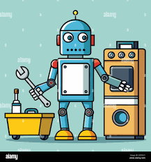
Fine-Tuned Models
Pre-trained language models are optimized for specific downstream tasks, in our case humor classification.
Does not require instructions, only labelled examples. But typically works with more training data.
Model weights are relearnt and optimized to better perform at the downstream task

Slide 18
 | Classification Label | Target | Rhetoric
DistillBert | ☑ | ☑ | ☑
Roberta | ☑ | ☑ | ☑
Electra | ... | ... | ☑
Gemma | ... | ... | ☑
Deberta | ☑ | ☑ | ☑
Microsoft Phi | ☑ | ☑ | ...
Models Tested

Slide 19
Tested Different Models on Each Category
Process
Process
For Classification Labels, Binary Models had a larger Batch Size
Instruction tuning
Fine Tuning
Used Class Weights Balancing/Hyperparameter Tuning (Learning Rate & Epochs)
Refined for Improved Accuracy

Slide 20
3
Results

Slide 21
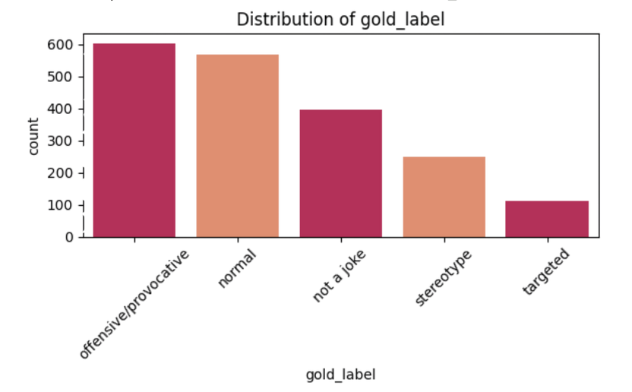
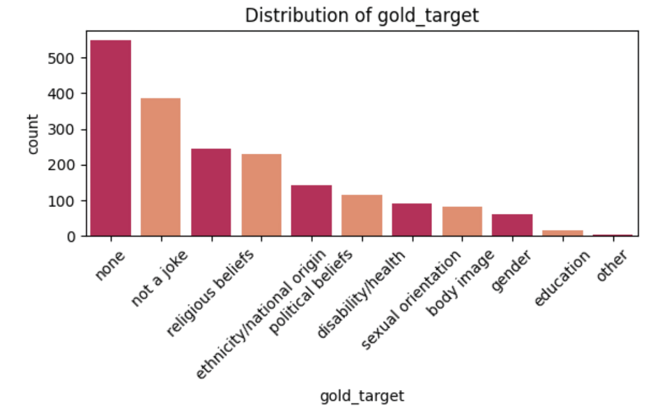
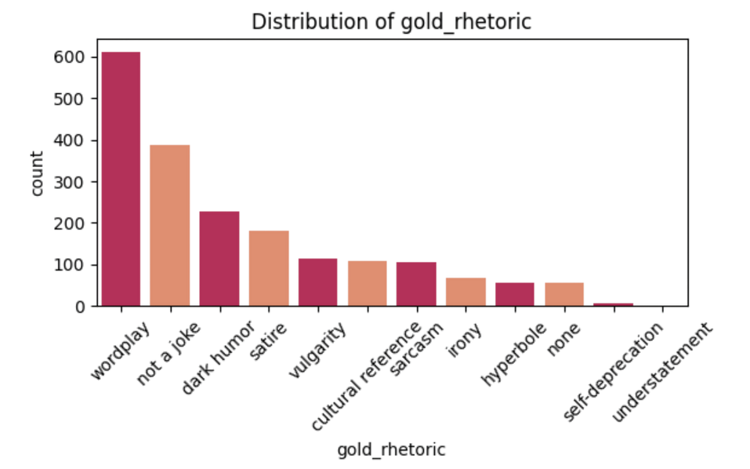
Data Collection & Overview
Dataset: Approximate 3.5k jokes sampled from a dataset of 100k+ jokes available on Kaggle
1921 labeled jokes for training
2538 unlabeled jokes for testing
Produce additional labeled data of 2.5k jokes following the proposed annotation framework

Slide 22
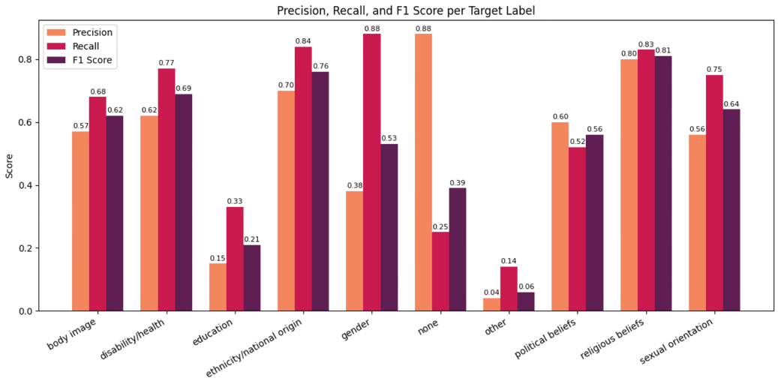
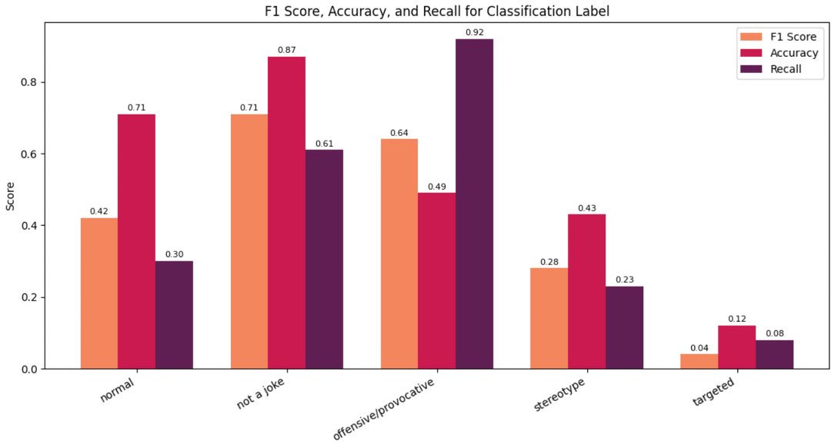
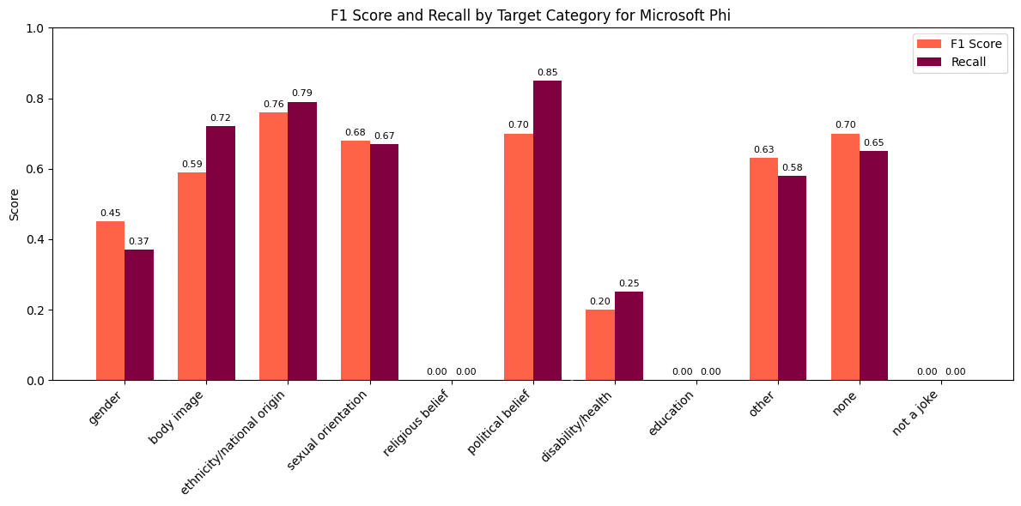
Instruction-Tuned Model Results: OpenAI

Slide 23
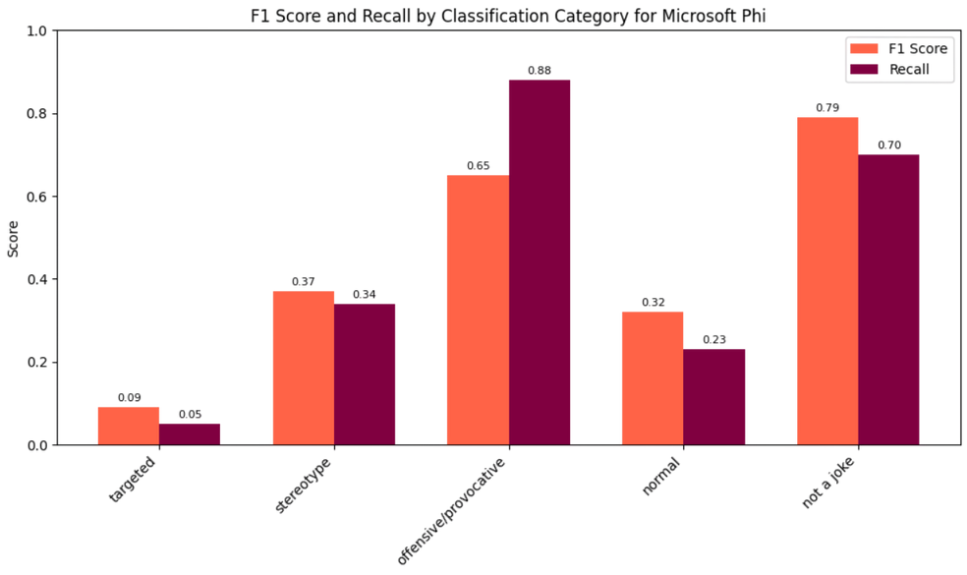
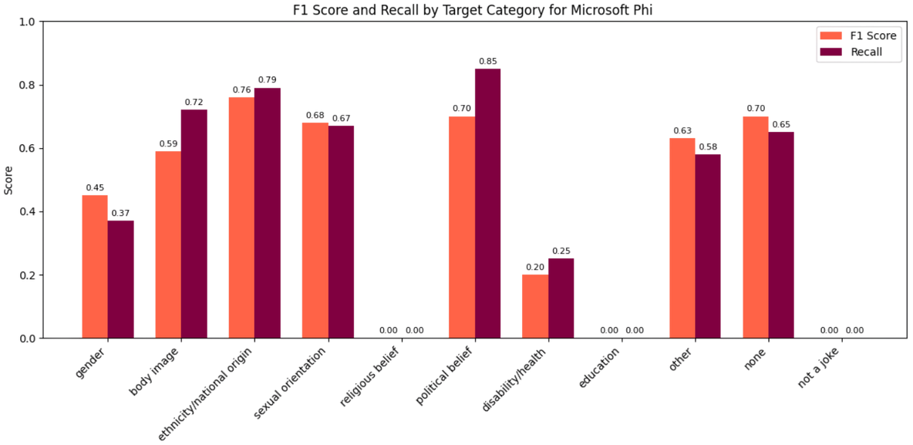
Microsoft Phi Results

Slide 24
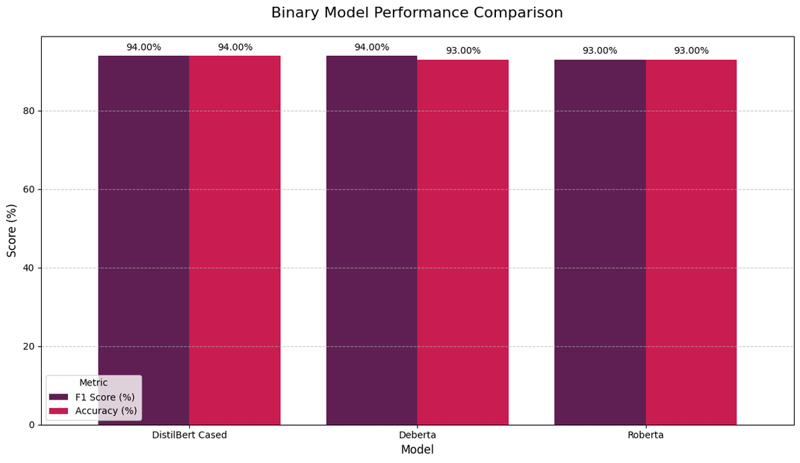
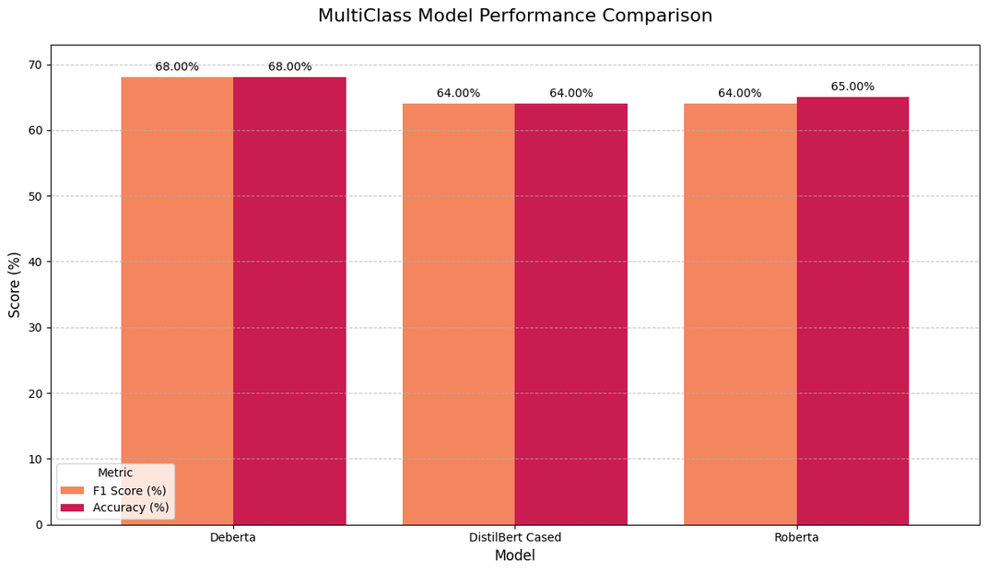
Finetuned Model Results: Classification Label

Slide 25
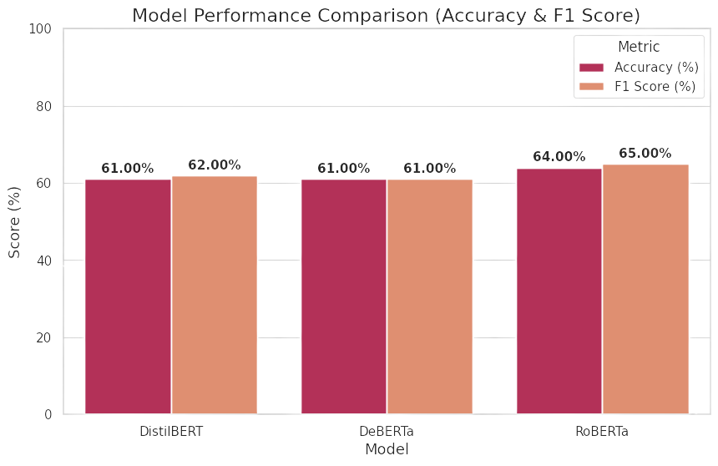
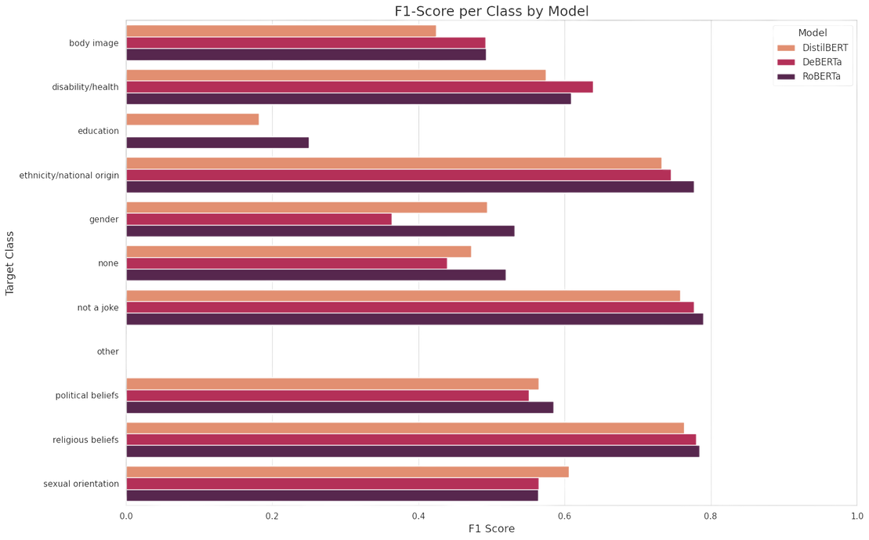
Finetuned Model Results: Target

Slide 26
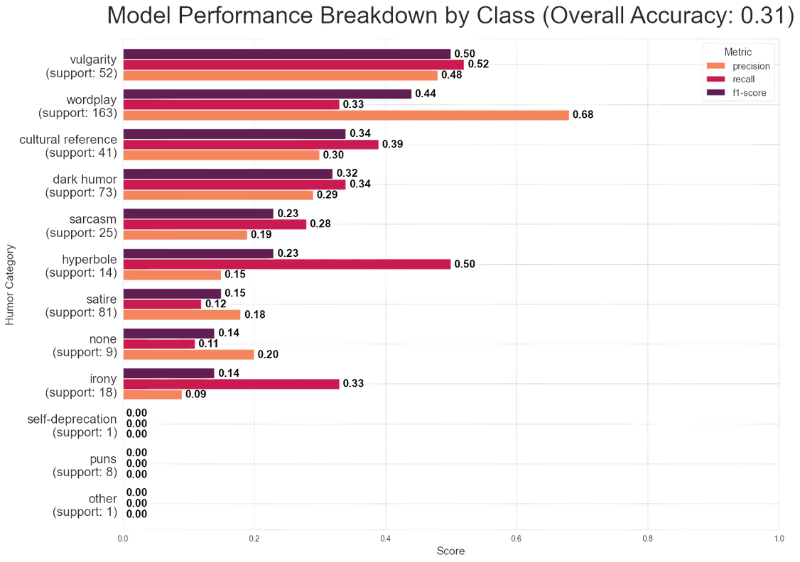
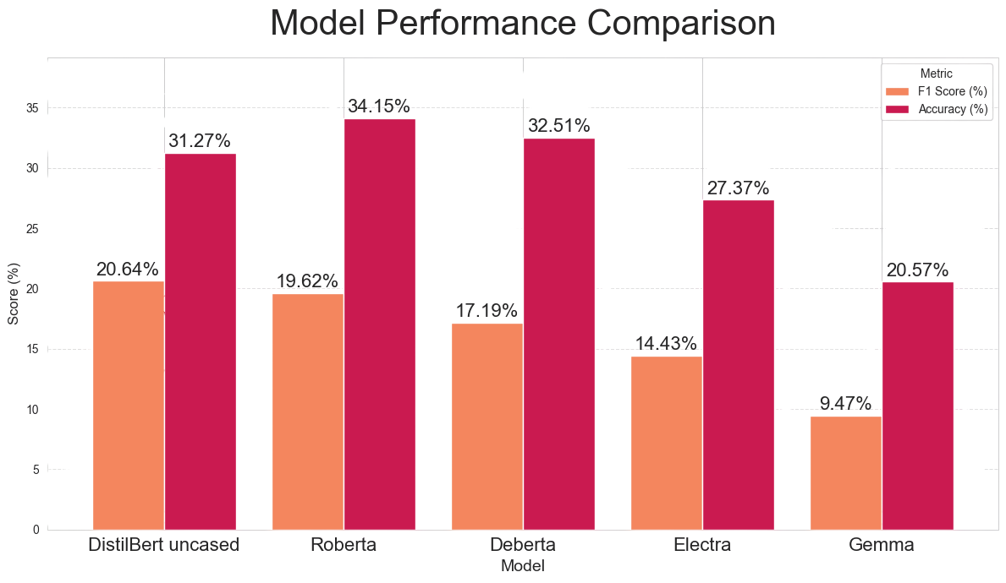
Finedtuned Model Results: Rhetoric

Slide 27
Annotation Agreement: Fleiss’ Kappa statistic
Fleiss’ Kappa statistic used to gauge inter-annotator agreement for more than 2 raters
Values range between -1 to 1
Values closer to 1 reflect higher agreement rates
Decent agreement among annotators for a fairly subjective task
0.82
0.78
0.89
Classification Label
Rhetoric
Target

Slide 28
Developed a novel humor annotation framework and proposed an annotation algorithm that bolsters consistency among annotators
Final Thoughts
Process
Instruction tuning
Tested a host of sota open source and proprietary language models to gauge the feasibility of our annotation framework in practice

Slide 29
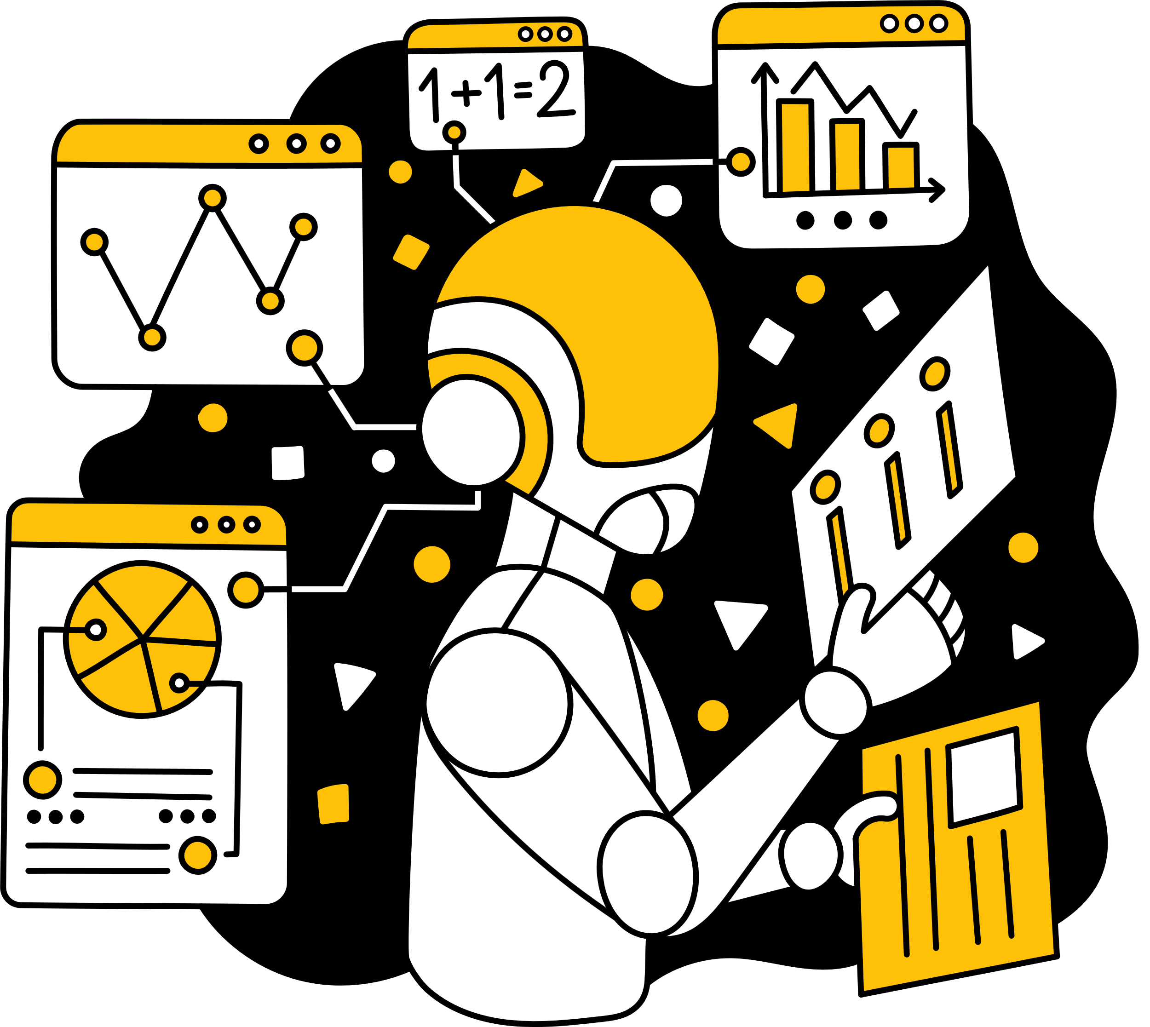
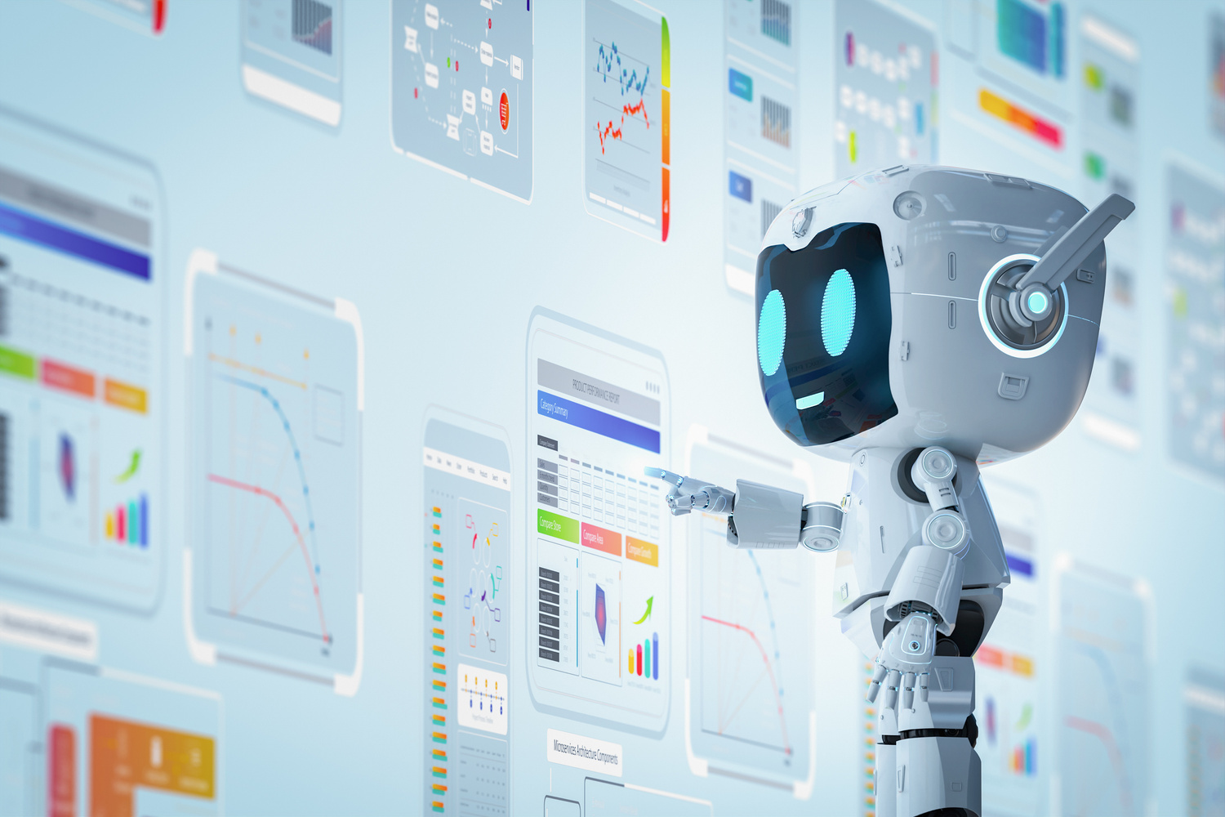

Future Work
Expand the scale of our labelled datasets
Improve baseline performances using additional humor-related features
Develop an abuse-detection language model and test if using humor labels improve their performance in identifying harmful text

Slide 30
References
Weller, O., & Seppi, K. D. (2019). Humor Detection: A Transformer Gets the Last Laugh. https://doi.org/10.18653/v1/d19-1372
Issa Annamoradnejad. (2020). ColBERT: Using BERT Sentence Embedding for Humor Detection. ArXiv (Cornell University).
Mao, J., & Liu, W. (2019). A BERT-based Approach for Automatic Humor Detection and Scoring. IberLEF@SEPLN, 197–202.

Slide 31
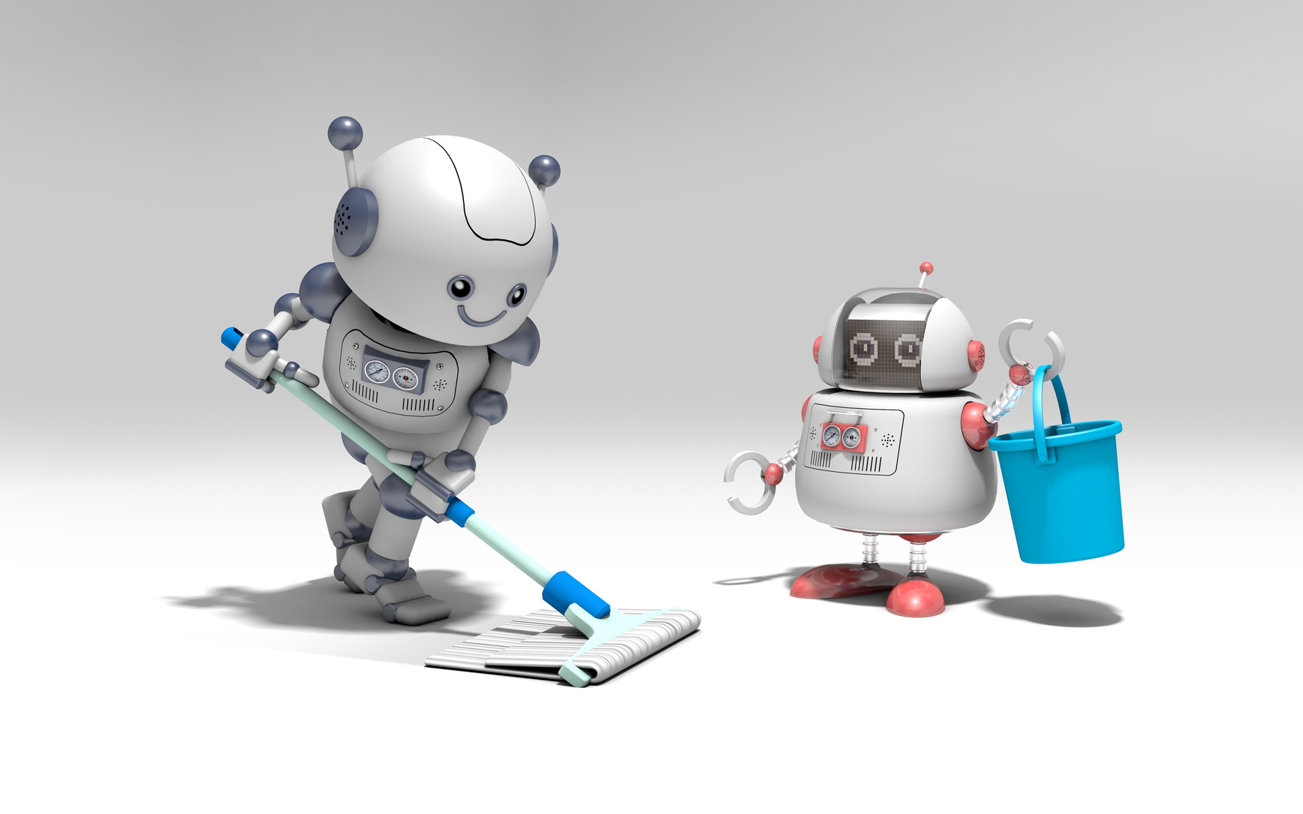

Questions?
Special Thank You To:
Dr. Patricia Chiril, Summer Han, Dr. Evelyn Campbell, & The Data Science Institute @ University of Chicago

